Slide 1

Global EV Sales Analysis
Presented by :
Punyamurthy Rahul Ratna Yadav
Batch.No : 470
Innomatics Research Labs

Slide 2
About me
My Name is Punyamurthy Rahul Ratna Yadav
I’m a recent Graduate in Bachelor of Technology in Artificial Intelligence and Data Science from GuruNanak Institutions of Technology .
I want to be a Data Analyst to do data exploration ,analysis ,create reports and dashboards ,decision-making.
LinkedIn : https://www.linkedin.com/in/rahul-yadav-0959ba299
GitHub : https://github.com/Rahulyadav1625

Slide 3
Agenda
Business Problem
Project Over view
Data Preparation
Dash Board Visualization
Applications
Recommendations
Challenges
Conclusion
Q & A

Slide 4
Problem Statement
Rapid growth in EV adoption globally and how does that helps other countries or cities to evolve in the same factor
Lack of Clear Insights into :
Which Countries Dominate EV Sales ?
Growth trends over time
In which year this EV boom has happened ?
These for data-driven understanding of EV market

Slide 5
Project Overview
The main objectives of this project are:
Analyze global EV sales using Power BI.
It involves data cleaning and visualization to generate meaningful insights.
Identify key trends and the growth patterns
Compare countries and the EV types
Track performance using the KPIs
Encourage the countries to use the EVs to help the environment

Slide 6
Data Preparation
Imported dataset into Power BI
Removed duplicate records to ensure data accuracy
Handled missing values
Fixed nulls and converted Total Charges to numeric
Created DAX for Total Sales, Growth Rate, Market Share
Ensured dataset is clean, consistent, and ready for analysis

Slide 7
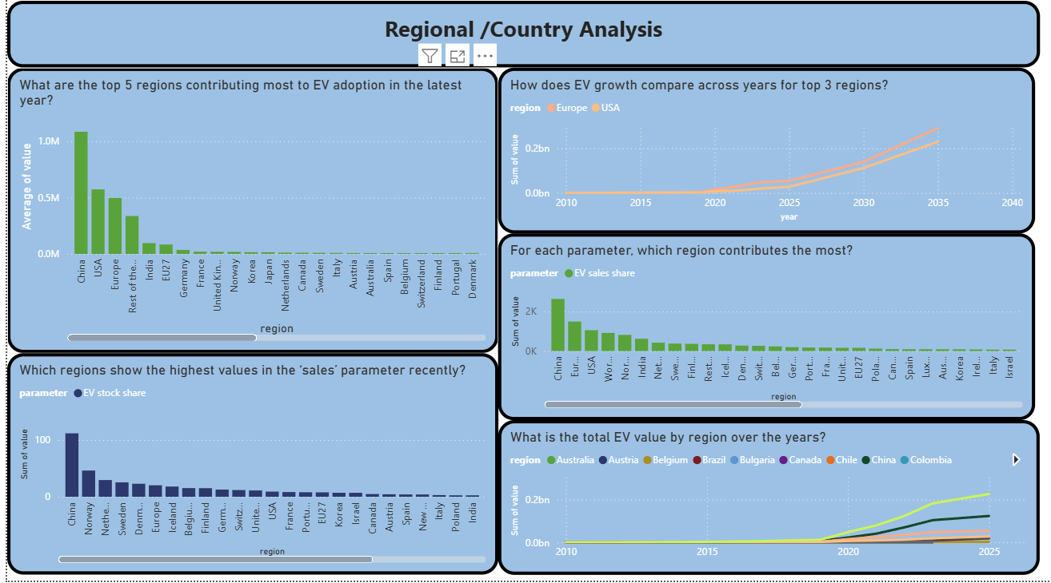

Slide 8
Dashboard Visualizations
Regional Analysis :
Visuals Used: Filled Map , Clustered Bar Chart
Goal : To Show geographic dominance
Key Findings :
China : Leads the world with over 11 million sales in 2024, Representing nearly 50% of its domestic car market
Europe : Stagnating growth (20 % ) share dure to phasing out of subsidy schemes in major markets
United States : Moderate growth (~ 10% ) reaching in a 1 in 10 sales share

Slide 9
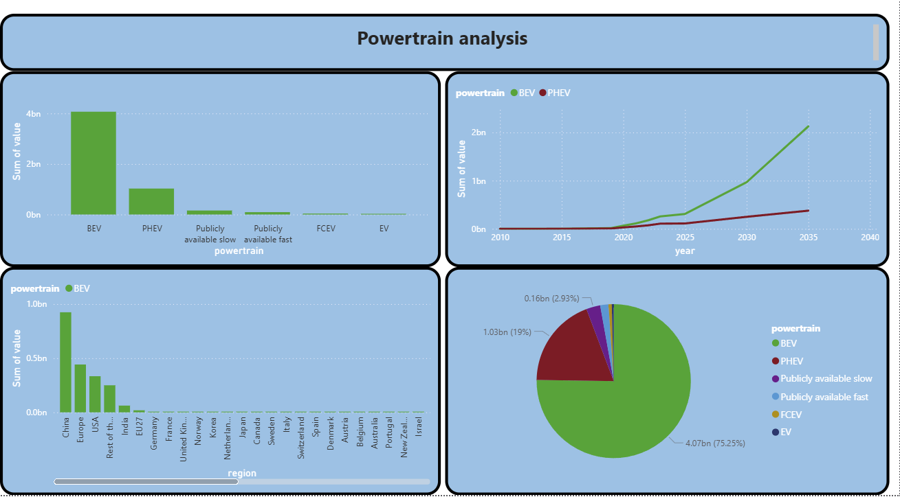

Slide 10
Dashboard Visualizations
Power Trian Analysis :
Visuals Used:
Donut chart , Stacked Column Chart
Goal : Compare Battery Electric Vehicles (BEV) vs. Plug-in Hybrids (PHEV).
Key Findings :
BEVs : Remain the dominate choice, accounting for roughly 70% of all electric sales globally
PHEVs : Seeing a resurgence in China, where sales surged by 78% in late 2024

Slide 11
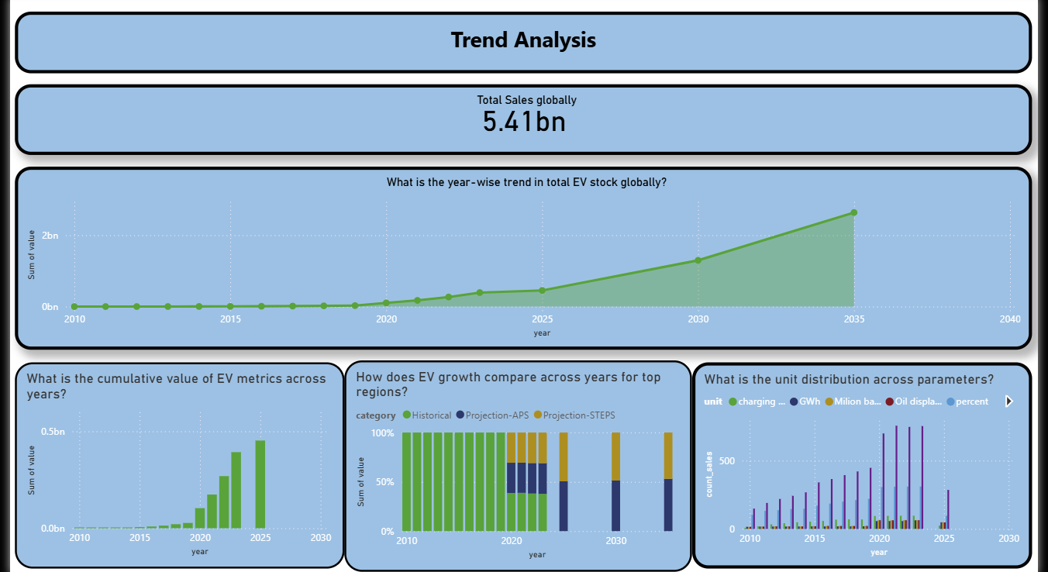

Slide 12
Dashboard Visualizations
Trend Analysis :
Visuals Used:
Line chart , KPI Card
Goal : Visualize the "Hockey Stick" growth curve since 2020.
Key Findings :
Global sales exceeded 17 million in 2024, which is a 25% increase from the previous year.

Slide 13
Key Insights
Record Breaking: Global EV sales share topped 20% for the first time in 2024.
Emerging Hubs: Sales doubled in Brazil and increased by 60% across other emerging markets in Latin America and Southeast Asia.
Policy Impact: Sudden regulatory changes or subsidy removals (e.g., in Germany) directly correlate with immediate sales dips.
Policy Support : Helps the governments design targeted incentive schemes to revive stagnant markets
Infrastructure Planning : Guides the deployment of charging points in high growth regions like southeast Asia

Slide 14
Challenges
Data Consistency & Integration: Reconciling datasets from multiple global sources (like IEA and regional databases) that used different reporting periods and vehicle classifications
Handling Sparsity in Emerging Markets: Managing missing historical sales data for smaller regions in Latin America and Southeast Asia without skewing global growth averages.
Complex DAX Logic: Developing sophisticated measures to calculate Year-over-Year (YoY) growth and rolling averages that accurately reflect seasonal sales volatility.

Slide 15
conclusion
Mainstream Adoption: The transition to electric mobility has reached a global tipping point, with EV sales share consistently exceeding 20% in major markets.
Regional Decoupling: While China remains the undisputed leader in volume, growth is rapidly accelerating in emerging economies despite stagnation in some traditional European hubs.
BEV Dominance: Battery Electric Vehicles (BEVs) continue to lead the powertrain transition, though Plug-in Hybrids (PHEVs) remain a critical bridge for specific regional consumer needs.
Strategic Imperatives: Sales trends prove that infrastructure availability and stable policy incentives are the two most critical drivers of sustained market growth.

Slide 16
Recommendations
Focus on Emerging Markets: Prioritize infrastructure investment in Brazil, Thailand, and Vietnam as they show high growth potential.
Affordability: Manufacturers should introduce more budget-friendly BEVs to maintain momentum as subsidies fade.
Retention: Implement loyalty programs for early BEV adopters to prevent them from switching back to ICE or hybrids.

Slide 17

THANK YOU

